Slide 1
Big Data : Retail Industry
Harshil Shah
Zoya Kadri
Deva krupa merupu
Praveen Kumar medapati

Slide 2
Applications of Big Data in Retail Industries
Create a Comprehensive Detection System for all Consumer Activities
Brand Sentiment Analysis
Personalize & Localize Shopping Experiences
E-Commerce Optimization – Basket Analysis, A/B Testing
Optimizing Store Layouts – RFID tags, QR codes, iBeacon Technology
Optimizing Inventory Status via Predicting Demand Cycles

Slide 3
Four V’s of Big Data
Volume
Variety
Velocity
Veracity

Slide 4
Volume
Customer identification data.
Descriptive data of your customers.
Quantitative data on your customer’s direct engagement to your business.
Qualitative data.
At the present rate, every two humans create more than all the data that existed up to the year 2003. Every two days!

Slide 5
Variety
Usage of Analytic Tools.
Restructure how you collect and store data.

Slide 6
Velocity
Make recommendations quickly for similar products on your customer’s purchases.
Use mobile marketing in order to reach more customers.
Marketers receive loads of history of their customers’ every click and interaction to their business and how you quickly respond to this matter.

Slide 7
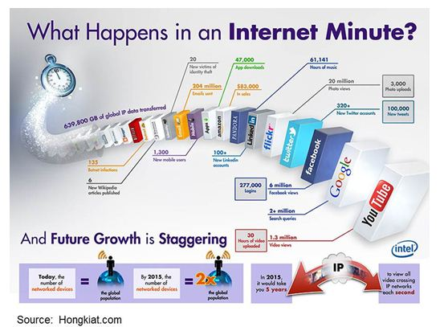
Veracity

Slide 8
Big Data Problems
Meeting the need for speed
Understanding the data
Addressing data quality
Displaying meaningful results
Storage
Privacy and security

Slide 9
Existing Solutions
Meeting the need for speed
Hardware – Increased memory + Powerful parallel processing
Grid Computing Approach, Map reduce, Sentiment Scoring
Understanding the data
Have proper domain expertize in place
Algorithms
Addressing data quality
Data visualization

Slide 10
Existing Solutions
Displaying meaningful results
Clustering data
Binning
Storage
Apache Hadoop and cloud storage
Algorithms - HDFS, HBase, Sqoop

Slide 11
Proposed solution
Control privacy breach and embarrassment.
Legal requirement for privacy policy.
Incorporate privacy and security controls.

Slide 12
Thank You

